Slide 1
Washington
Miracle, Kannie, Lin, Tanzina

Slide 2
Intro to Washington (K)
Washington is located in the Pacific NorthWest region of the United States.
The governor of Washington is Jay Inslee, who has held the position since 2013.
Washington State is diverse, so there are many traditions, but many popular ones include…
Arts/sports festivals such as the Apple Cup and Lightning festival
The state has had about 71,595 cases and about 1,911 deaths.
Most of these cases were located in King County with a total of 18,149 cases and 720 deaths.
There was a rise in cases around July, as places were starting to reopen and the temperature was rising.
There was a total of 1,261 cases on July 15, which was the high record for Washington state.

Slide 3
Washington’s Response (L)
After the first case of the novel coronavirus, the state’s Dep.of Health began working closely with the CDC to begin contact tracing and monitoring people who might be exposed
Some regulations are to stay home, face masks, quick trips, stay local to the community, limit social gatherings
Testing for COVID-19 has steadily risen in the state and drive-through testing became available in some communities in late-March
There is a call center that can be called regarding any questions about the virus and they can be reached at 1-800-525-0127

Slide 4
Other Factors (M)
The average age in Washington State is 37.6 (United States average: 38)
There 3,034,500 non-elderly men and 1,519,000 non-elderly women with pre existing conditions
Government restrictions depend of the phases of each county, however most counties are phase two which some in phase one and three. Phase two allows for…
Most outdoor facilities to reopen with restrictions, such as wearing masks, operating at partial capacity, and restricting close contact activities.
Gatherings with people outside your home/family group are limited to five
Some indoor facilities are opened at partial capacity with restraints. Restaurants/bars must serve food, and tables/operating times are limits.
Non-essential business is restricted

Slide 5
Current Events (T)
A state-wide mandate for mask wearing in in any closed place that is not the home itself (not only in public buildings) was passed on July 27th
The department of Health also requires anyone who tested positive for COVID 19 to self isolate. Isolation periods last until ten days after the individual has stopped showing symptoms and doesn’t need medication to reduce them
The Washington State Department of Health on Thursday reported 700 new confirmed cases of COVID-19 and 15 deaths.(8.20.20)

Slide 6
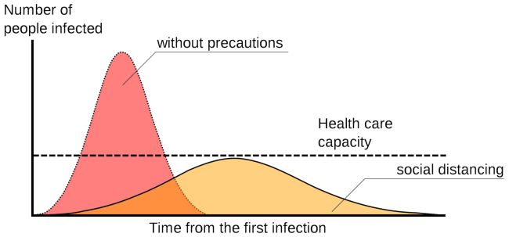
“Flattening the Curve”(L)
“Flattening the curve” refers to measures taken by the community to keep the number of disease cases to a level that is manageable to for healthcare providers. The goal for many places around the world is to slow the spread, so fewer people need to seek treatment. The curve refers to the projected number of people who will get sick over a period over time.

Slide 7
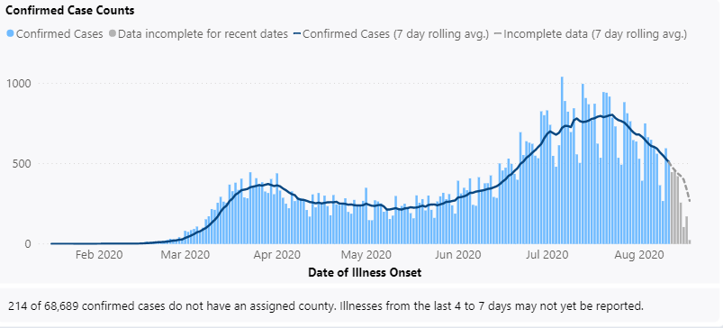
Hypothesis (M)
Based on the trends featured on the Dep. of Health, it is likely that by November, Washington will flatten the curve and reduce the increase of their cases. The following visualization represent the confirmed new case counts each day.

Slide 8
Project Goals (K)
Primary Visualizations:
Create bar plots on the number of cases and deaths over time for Washington and geographical choropleth maps for the United States
Research factors in Washington that may affect the number of of these cases and deaths.
Create a hypothesis about how the curve will flatten
Why Choose to Code?
Coding gives people the ability to display and plot information, making it easier for people to study the information or a topic
This also allows the public to view visualized data instead of looking at a bunch of numbers
Code gives us the ability to do different types of things such as designing, sorting data, and separate information.

Slide 9

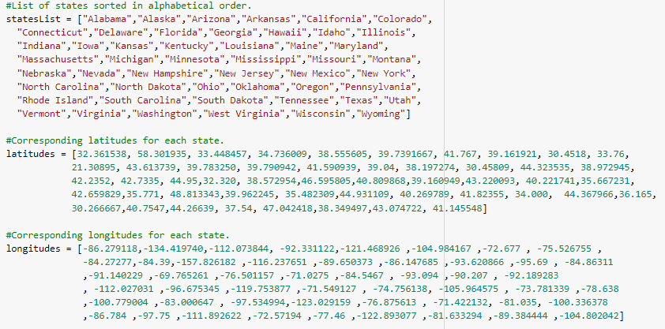
Our Code (T)
3
2
1

Slide 10
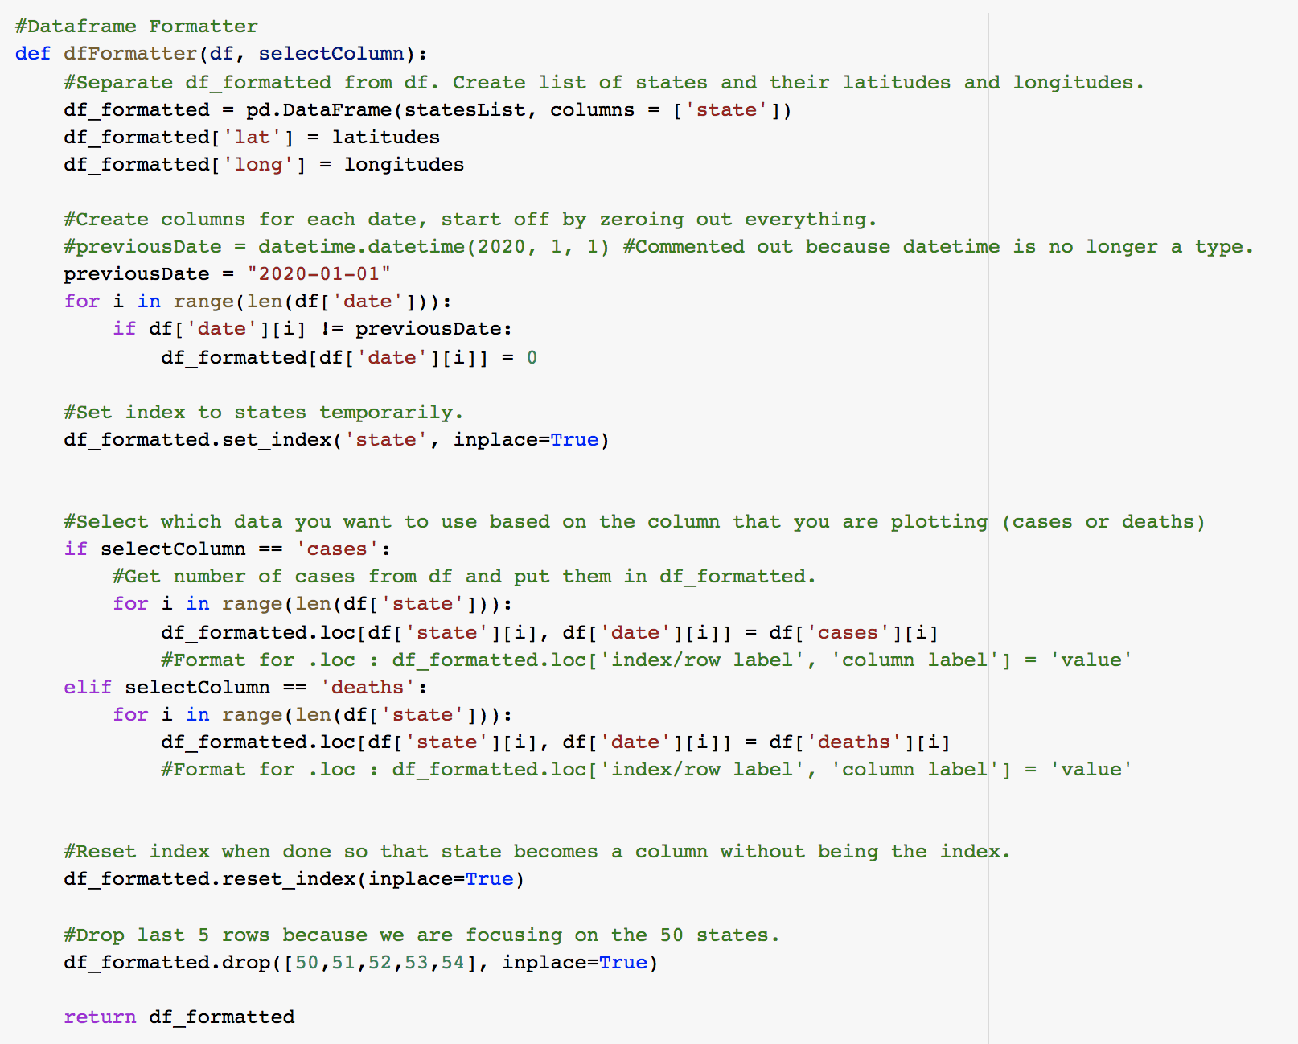

Slide 11
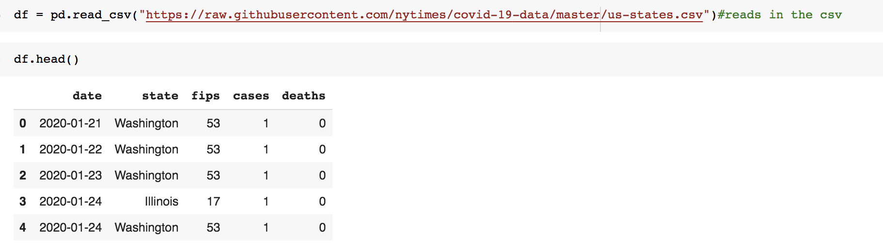
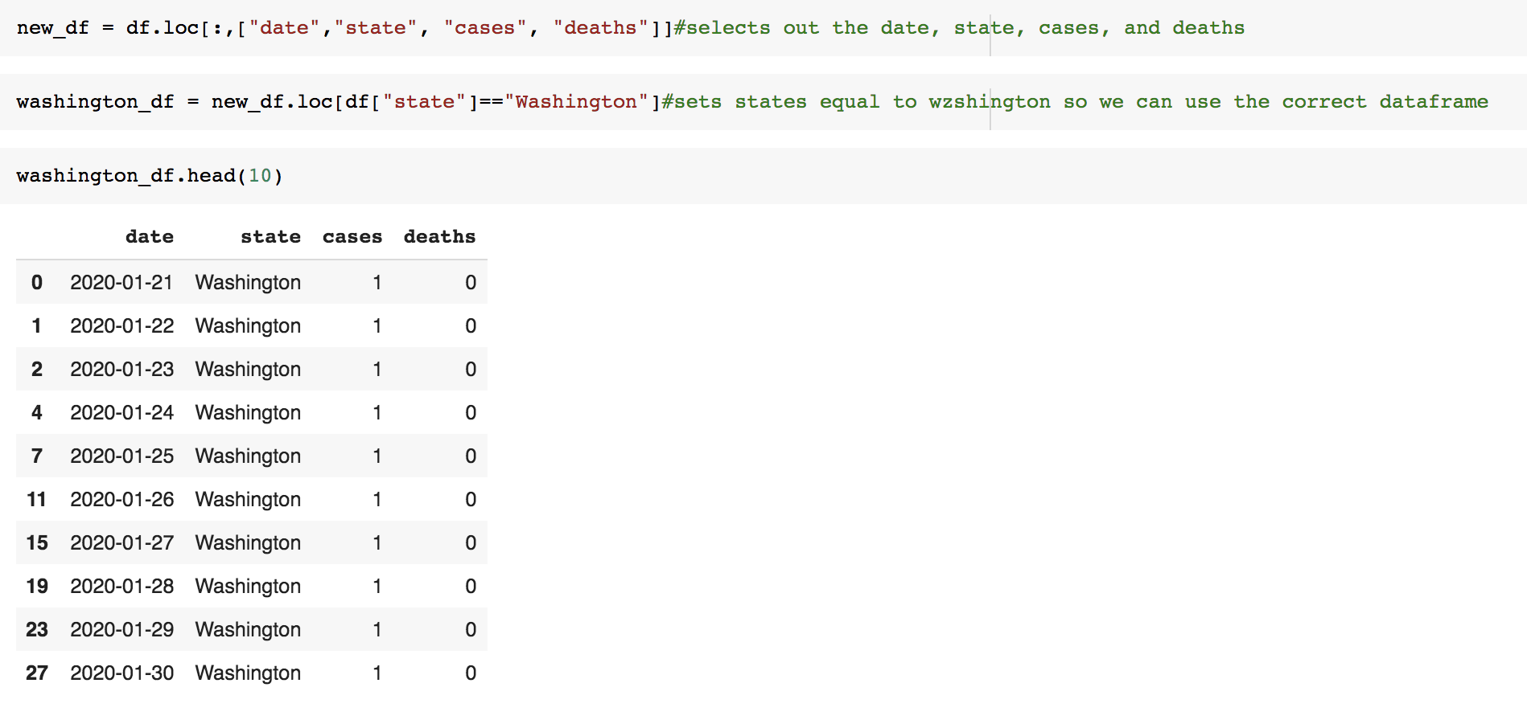
K
Notes:
We used pd.read_csv to read the data and to create the dataframe
We displayed the first 5 rows using df.head()
We only wanted columns date state cases and deaths so we created a new variable with df.loc to remove figs from the chart
We also used df.loc to only display washington data into the chart

Slide 12
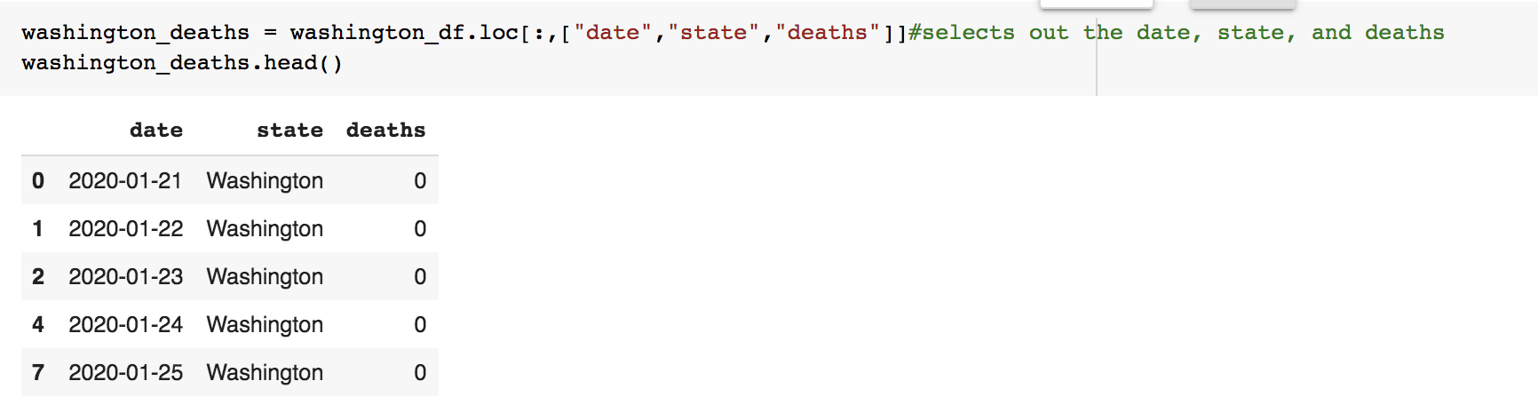
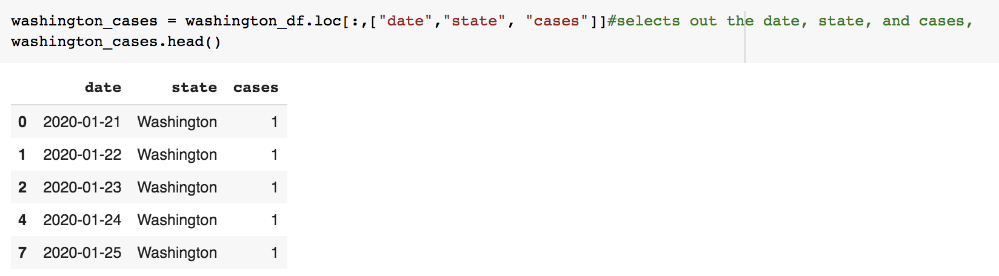
L

Slide 13
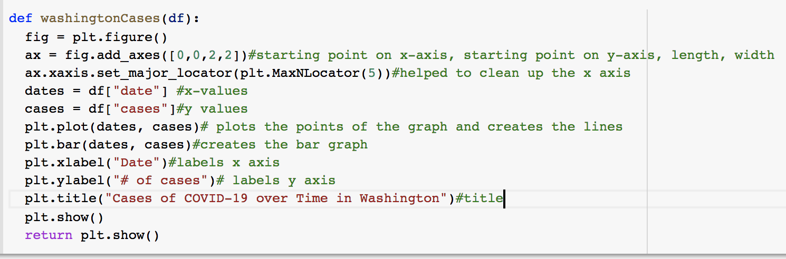
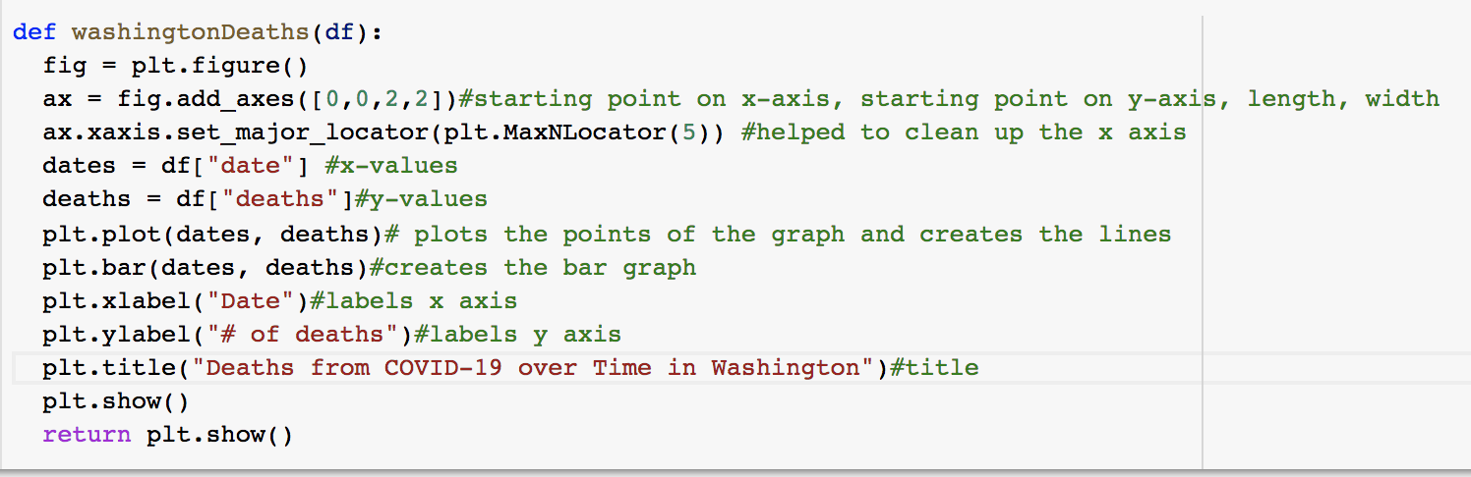
T

Slide 14
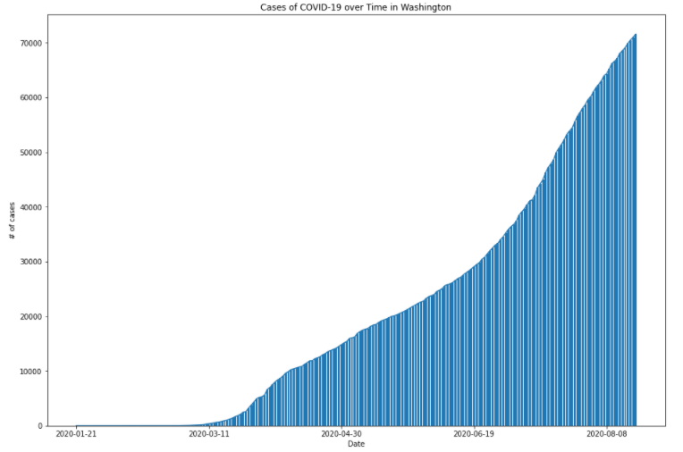
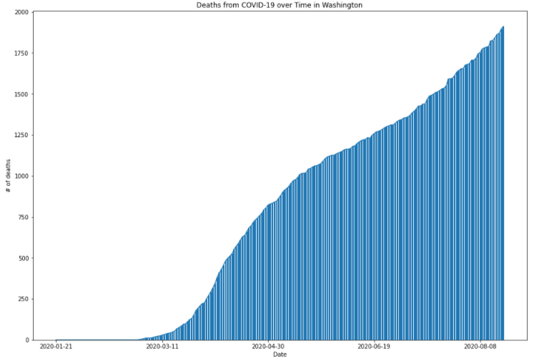
Primary Visualizations
T

Slide 15
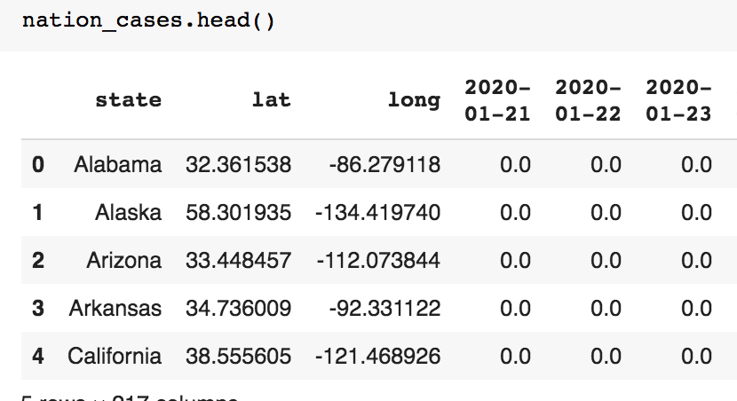
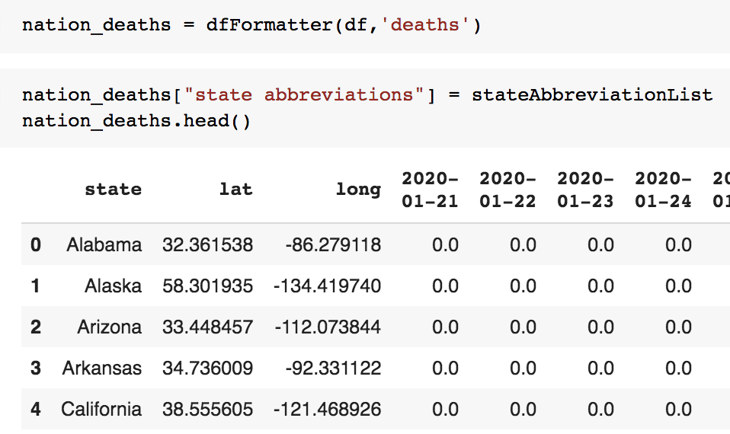
1
2
3
M
Notes:
The new column, which is not visible,is featured at the end

Slide 16
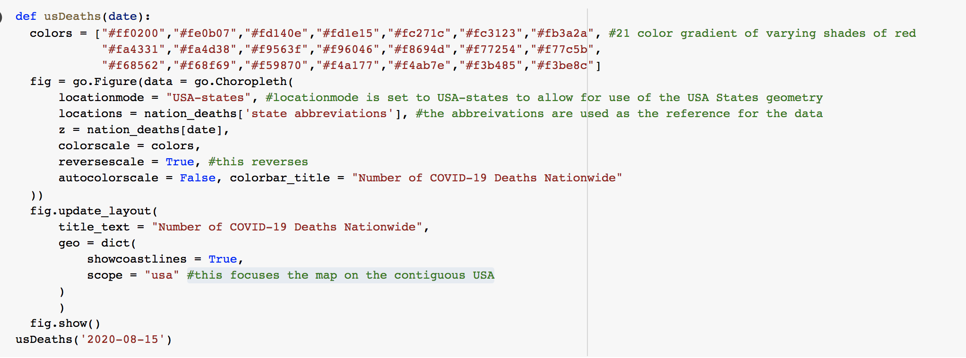
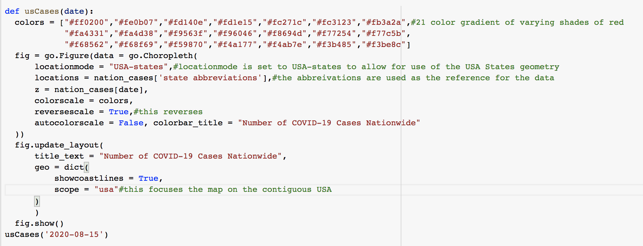
L
Notes:
The scale needed to be reversed to better portray the intensity

Slide 17
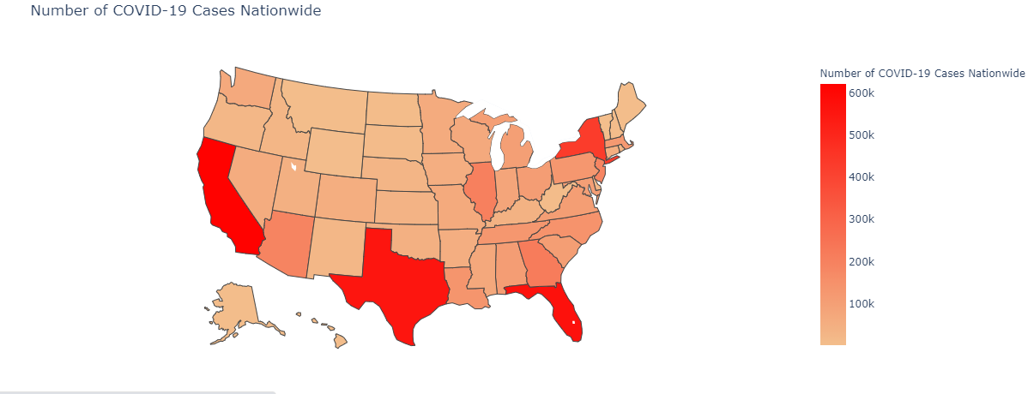
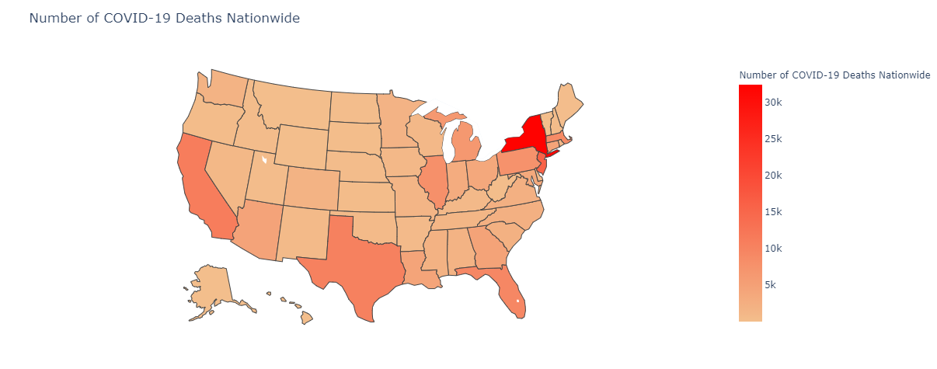
Primary Visualizations
8.15.20
L
Notes:
As of Aug. 15th 2020

Slide 18
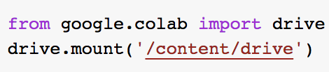
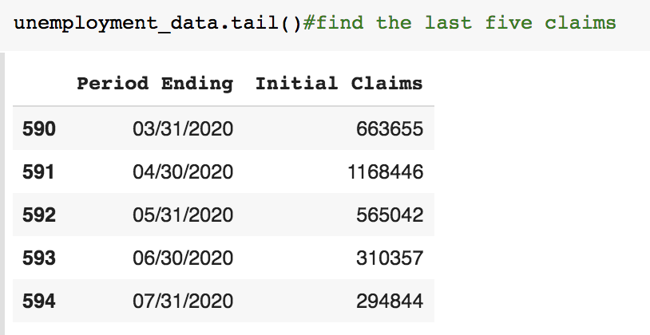
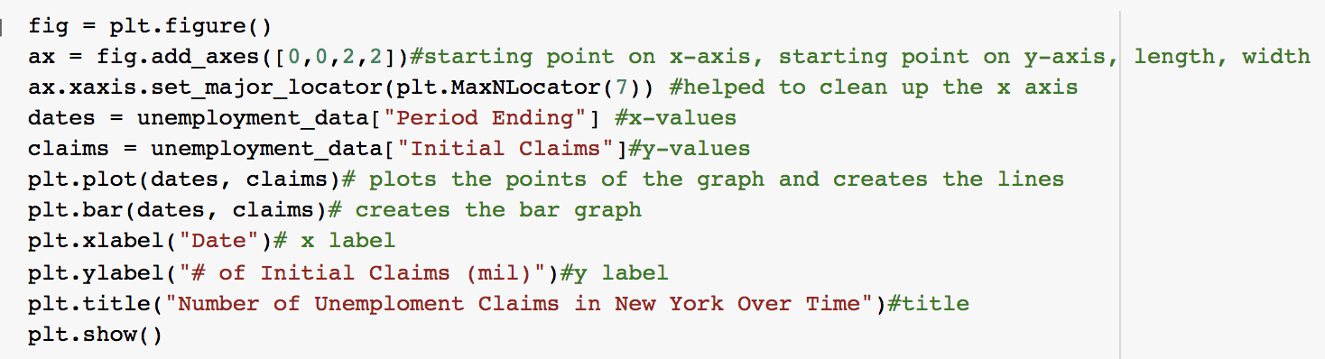
1
3
2
K
T
4
Notes:
The csv path had to be download then uploaded to drive
We named the file unemployment data and displayed the last five claims using .tail()
We used plt.figure and named the variable fig
Ax was used to add the starting point on the xaxis and yaxis length and width
After we cleaned it up with axaxisssjfsljfs
Dates is contains out xvalues claims contains out yvalues
Plt plot plots our points plt.bar creates

Slide 19
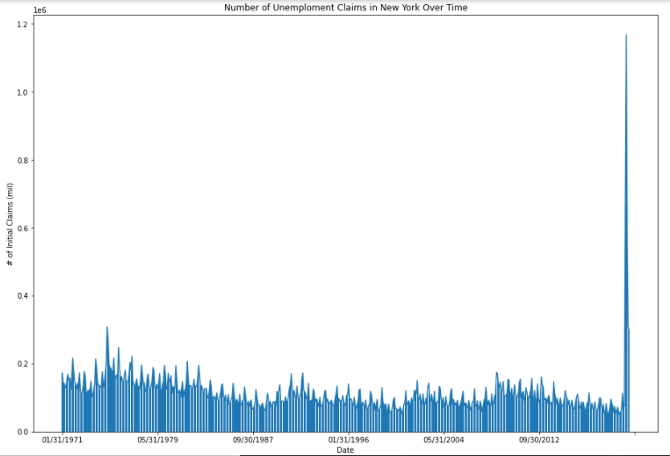
Secondary Visualizations
K
Notes:
After coding our data, we got this chart
There is a high number of initial claims within the last few months
The highest unemployment rate ever recorded happened during corona as many people lost their jobs due to the pandemic

Slide 20
Conclusion (T)
Takeaways
We can conclude that Washington state will most likely flatten the curve by November. Despite the fact that our data disproves this, we believe that the mandates Washington has implemented will allow the COVID 19 cases to decrease. The visualization we used to base our hypothesis showed daily cases count rather than the total case count, like our graphs did and showed a decrease.Scientists are continuing to research this virus to create vaccines, and the best ways to fight against it so we believe that Washington state will most likely flatten the curve by November. However, because of the upcoming holiday seasons, we cannot say for certain that the curve will stay down.
The Brown Scholars program has helped us realize the importance of code, it is used in everyday technology and is continuously advancing. It’s so versatile and we really appreciate learning how to code as well as anyone who codes. Even just coding a simple map can really help simplify and allow for a deeper understanding of topics.

Slide 21
Challenges and Solutions (M)
We didn't write in the state abbreviation and we couldn't make the choropleth map
We went through slack to look for any info she might of sent later
Some of our graphs were not matching up
So we shared our screen and spoke through our code
We really didn’t understand how to change the map from the whole world to the usa
We got help from a classmate outside of the group who explained how to change it
The covid cases and deaths graph was messed up at the y- axis
So we went to office hours and one of the TAs helped write a piece of code that helped space out the dates
Our x-axis for the graphs of cases and deaths showed each individual date, resembling a blob
We asked Carol and Erika for help in office hours and during the process

Slide 22
Next Steps (L)
Write code that portrays the case and death count of USA at different dates throughout the start of the pandemic and compare how the data has changed
Write a code that highlights the state that we studied, Washington, the choropleth map
Do the challenge and study other factors and effects of the pandemic, such as companies filing for bankruptcy and hospitalizations.
Create functions for the graph codes so it’s easily accessible to reuse in other projects

Slide 23
Bibliography
https://www.doh.wa.gov/Newsroom/Articles/ID/1071/Update-on-response-to-2019-novel-coronavirus-in-Washington-state-20-008
https://www.livescience.com/coronavirus-flatten-the-curve.html
https://www.seattletimes.com/seattle-news/education/its-unsafe-for-most-of-washington-students-to-return-to-school-buildings-this-fall-says-gov-inslee-schools-chief/
https://familiesusa.org/wp-content/uploads/2019/10/ACA_Preex-National-Table.pdf
https://www.cdc.gov/coronavirus/2019-ncov/covid-data/covidview/index.html
Any Questions?

